Slide 1

An Introduction to Odoo
The new definition of RAD for business
Pouya Malekineajad • Research and development

Slide 2
1
Introduction
2
Odoo story
3
Technical intro
4
Example Application
5
Conclusion

Slide 3
1
Introduction
What is Odoo?

Slide 4
Remember RAD?
Rapid Application Development changed the way we make apps.
And Django was born. We started to use components.
…
But business apps share the same ecosystem
80% of business logic is shared
Odoo has the standard components of business

Slide 5

Here comes Odoo
Open Core on github
Mature ORM
QWEB Template Engine
OWL Web Framework
RPC API
Built-in Security
web-RTC
Multi Processing
All Integrated!

Slide 6
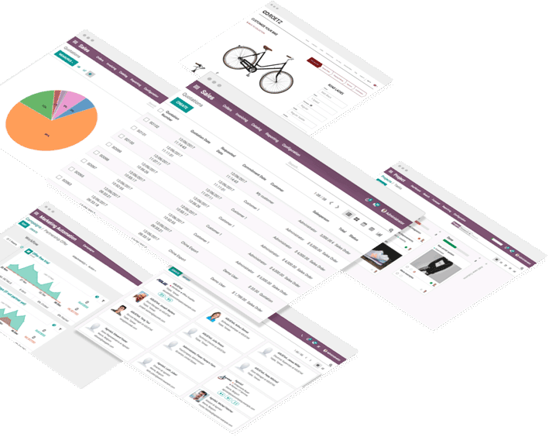

“
All-in-one management software. Beautiful. Easy-to-use.
Our product
“

Slide 7
2
Who we are,
Odoo’s Story

Slide 8

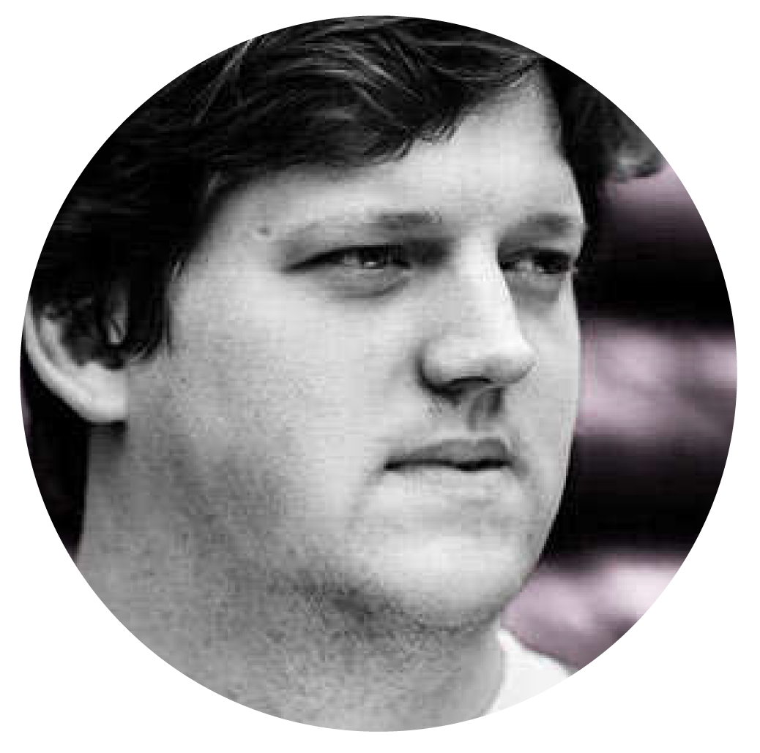
“Our mission is to help companies grow. We want to unleash companies’ potential by empowering users with tools they love.”
Our mission
Fabien Pinckaers
CEO & Founder

Slide 9

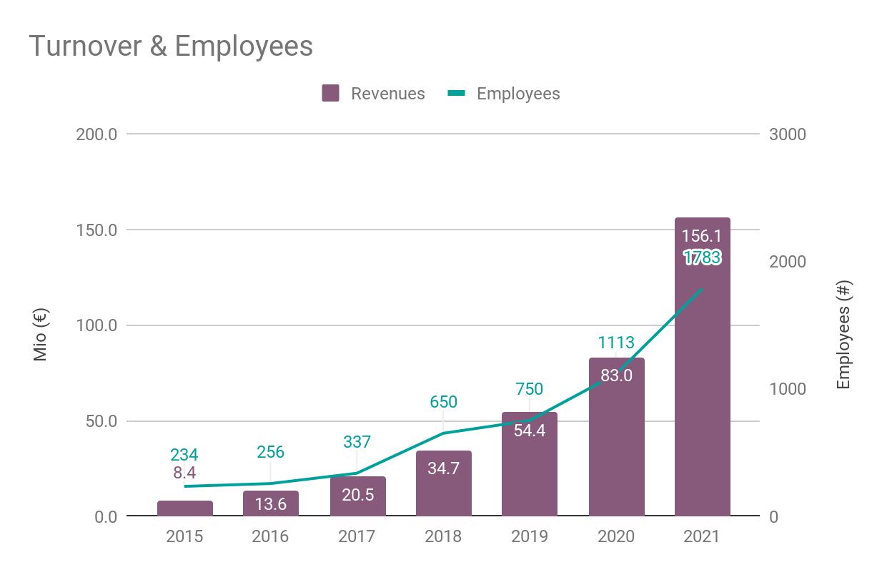
￼
Key Figures
2036
4100
Employees
Official Partners
70%
7 Mio
Growth rate
in 2021
“Happy Users”
175
22k
Countries
Enterprise
Customers
Notes:
Système de gestion qui est le plus utilisé dans le cloud

Slide 10
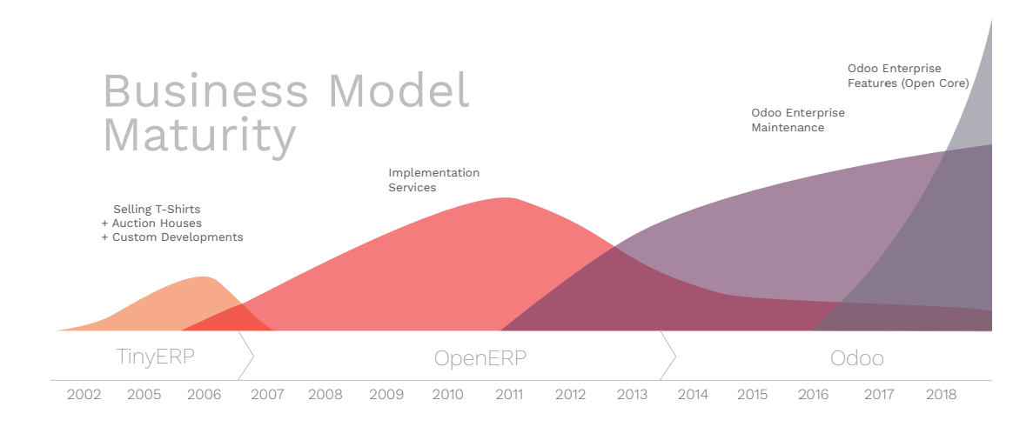
It started with a dream
Read the story in Linkedin
How I Grew From 1 To 250 Employees In A Few Years

Slide 11
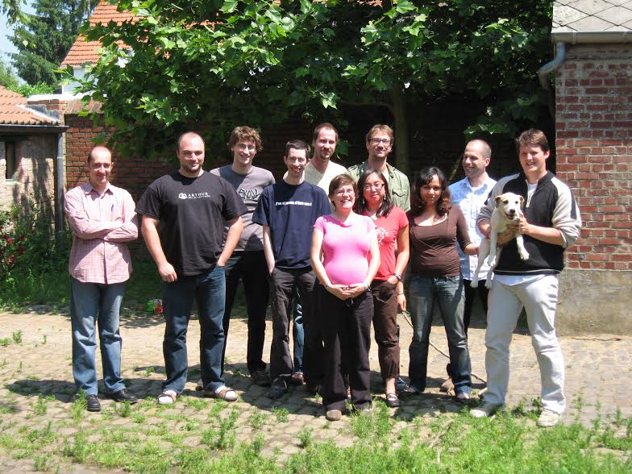
Back in 2007
Notes:
That was the team in 2007. IT was a hard time; we were a small company, we had financial difficulties.
People had to work nights, and all we could afford was small salaries. But we loved what we do and we worked hard.
(goal: people should identify themselves to this)

Slide 12
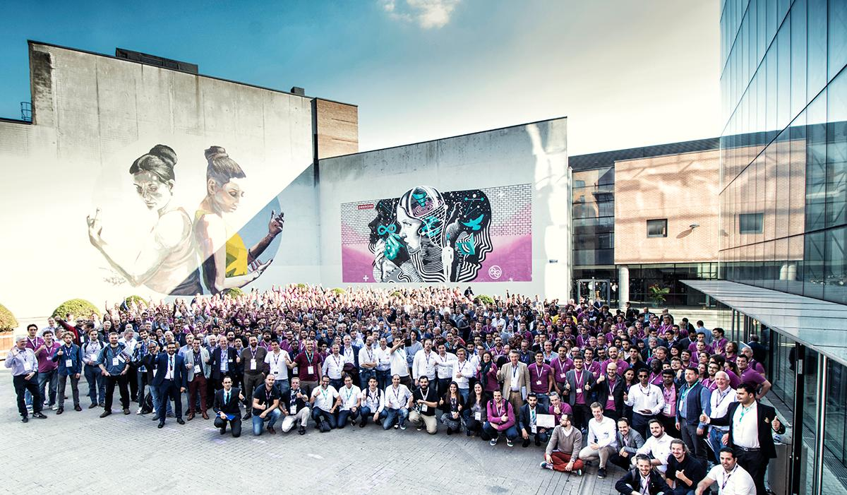
In 2019
Notes:
And, now, we have 580 employees.

Slide 13
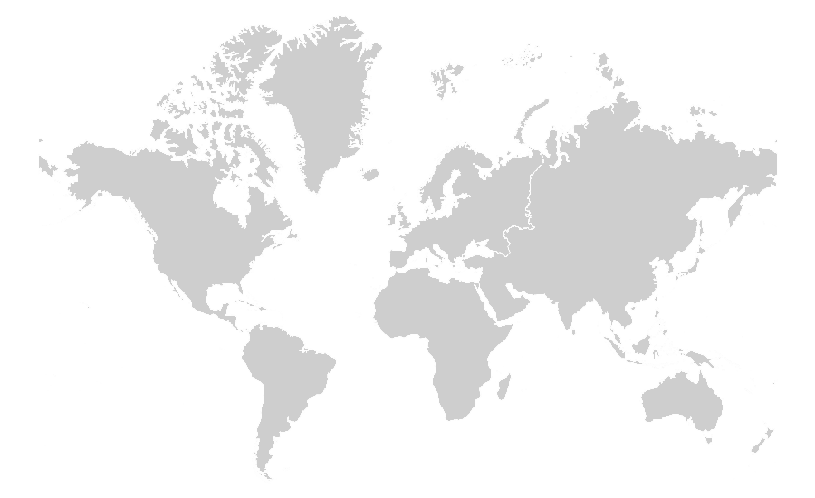
Our 11 offices
Louvain-la-Neuve
Antwerp
Grand-Rosière
San Francisco
Buffalo
New-York
Luxembourg
Mexico City
Hong Kong
Gujarat
Dubai
Kenya

Slide 14
?
How did
we do it?

Slide 15
We built the best software!
Notes:
The good news: now, with Odoo, any company can benefit from this flexibility, for just 18€ / user / month.
With Odoo, you get top notch hundreds apps accessible in just a click.
No more IT project every time you want to change something. Just install or customize an app.
Need an eCommerce, just install an app, need more leads; just install an app, need to automate invoice or subscriptions; install an app...

Slide 16
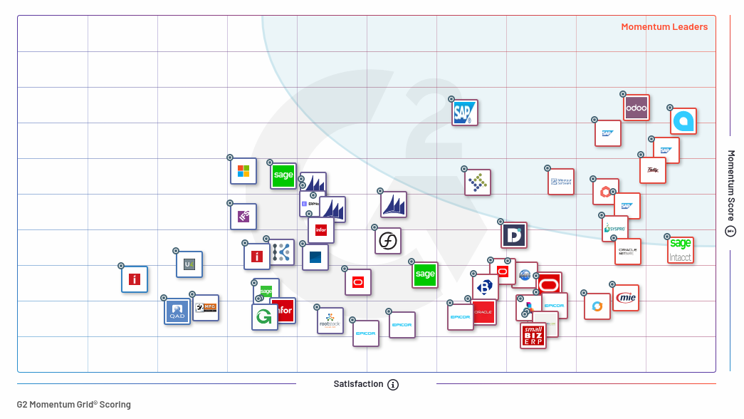

Slide 17

Our positioning
We are offering a user-friendly tool that is covering most of the companies’ business needs

Slide 18
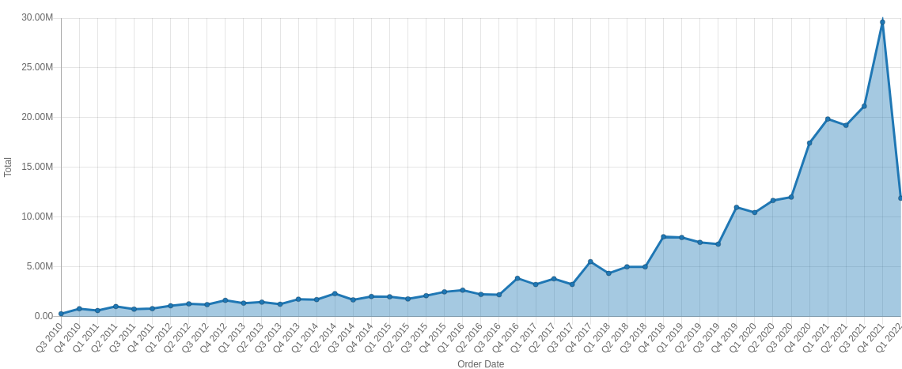
Fast Growing Company
2036 employees, plan to add 1000 more in 2022

Slide 19
3
And finally,
Technical Introduction

Slide 20
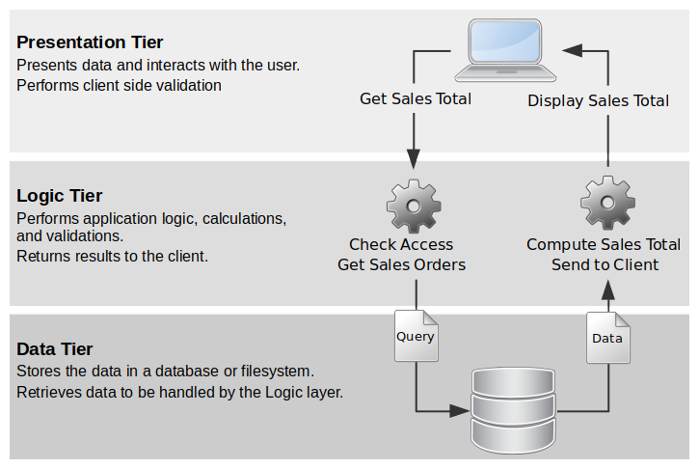
multi-tier architecture
Presentation Layer
OWL JS framework
QWEB Templates
Logic Tier
ORM, Python framework
Data Tier
Postgresql

Slide 21
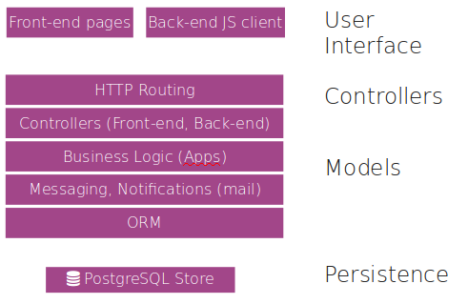
Multi-tier architecture
Presentation Layer
OWL JS framework
QWEB Templates
Logic Tier
ORM, Python framework
Data Tier
PostgreSQL

Slide 22
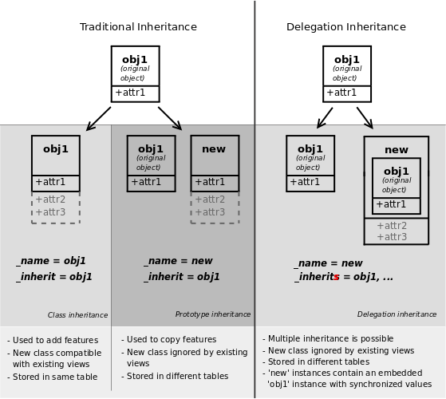
Modular by Design
Modularity is not just having modules

Slide 23
Module anatomy
Model
Data structure and logic, Python
View
Standard views (list, form, kanban, graph,...), and menus, XML
Security
Access rights on models and records, XML & csv
Static
Web stuff, Widgets in XML and js
Reports
PDF reports template in XML

Slide 24
Module anatomy
Portal
Portal pages, Python and XML
Data
Data records and demos, XML or csv
Web controllers
Handle html requests directly
And Tests
In Python and JS

Slide 25
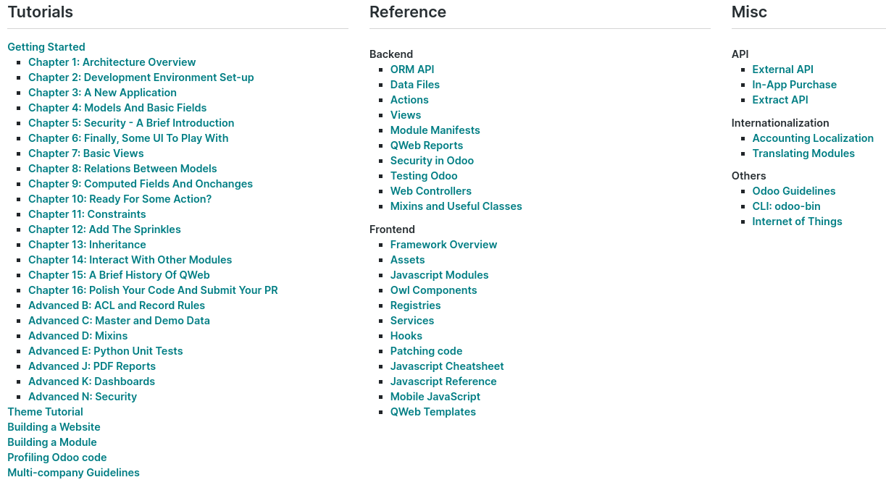
Find The Documentation in
https://www.odoo.com/documentation/15.0/developer.html

Slide 26
4
See some action,
Building An App

Slide 27
A bookshop
A bookshop owner wants a software for her business.
She needs to:
know how many of each book she has in her shop
Search by title and author
Order the books that are low in stock
Print invoice for customers and control cash flow
Sell books online
Keep track of her customers

Slide 28
Analysis
know how many of each book she has in her shop
Inventory module
Search by title and author
Special model for author, books are generally products here
Order the books that are low in stock
Purchase and inventory modules
Print invoice for customers and control cash flow
Sales and invoicing modules
Sell books online
Website and E-commerce modules
Keep track of her customers
CRM Modules

Slide 29
5
and,
Conclusion

Slide 30

Innovate, be disruptive.

Slide 31
Thank you.
2022
#irPyCon
Indulge me with your questions
https://www.odoo.com/r/CxQG

Slide 32
There is no magic formula for great company culture. The key is just to treat your staff how you would like to be treated.
— Richard Bronson

Slide 33
It matters for people.
We spend 20% of our life at work.
Better do it with a purpose, building something awesome, in a fun environment where we can continuously learn.
A great working environment allows innovation, ability to execute faster and good performance.
www.odoo.com

Slide 34
 | Then | Now
Focus | Career | Purpose
Need | Great managers | Inspiring leaders
Hours | 9-5 | Whenever
Aspire to | Manage | Evolve
Tenue | Whole career | Whatever

Slide 35
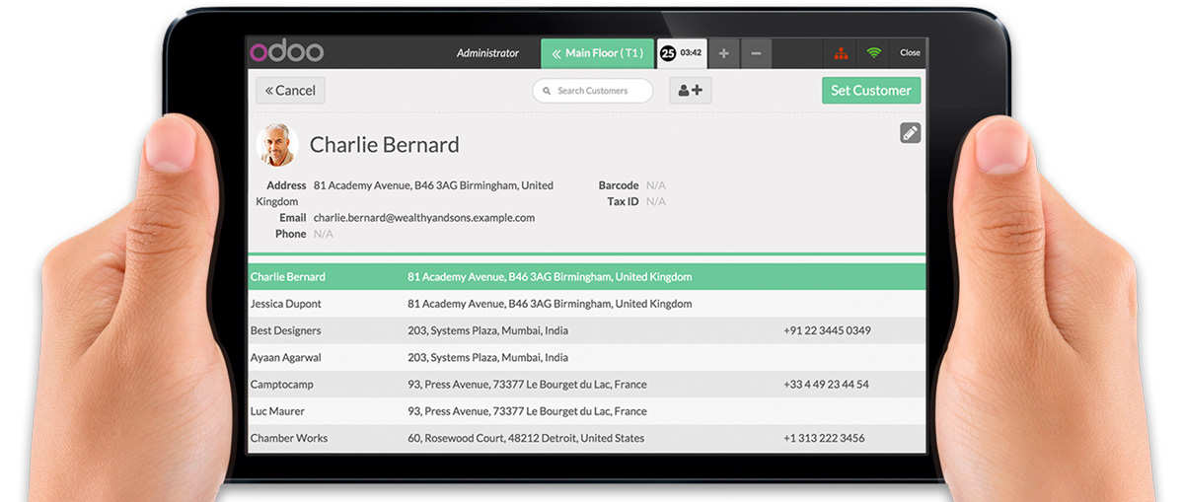
PoS for Restaurant
Keep in touch with your customers.
And keep them coming back with loyalty programs.

Slide 36

A great working environment allows innovation.

Slide 37

We focus on building the perfect customer experience.

Slide 38
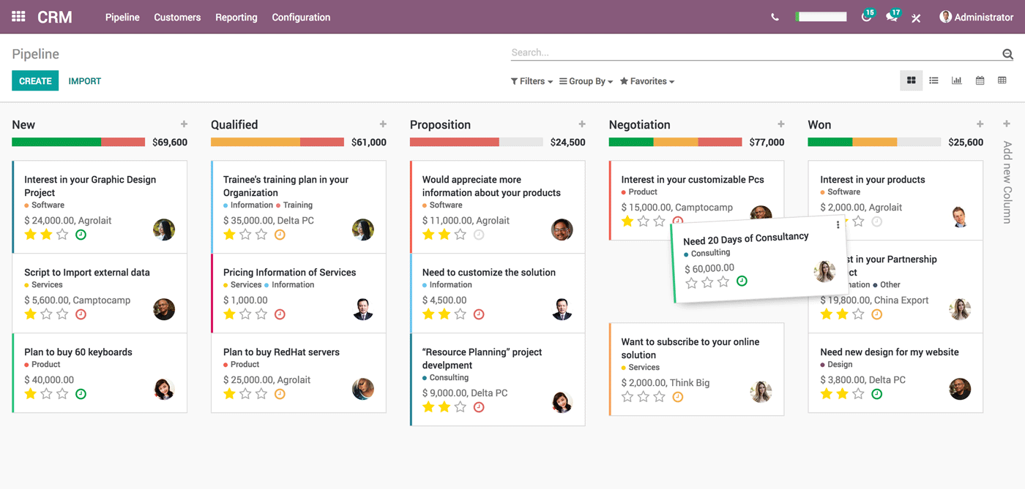
Omnichannel sales
Our mission is to transform the way companies run their business.
We make it simple & fully integrated.

Slide 39


Slide 40


Slide 41



Slide 42
Like software,
organisations should be
frequently
refactored
Refactoring means to improve internal structure without changing external behaviour.

Slide 43
Refactor.
Remove unnecessary rules
Stop useless reports
Cancel unproductive meetings
Stop complex process
Pull out unused features
Shorten contracts size

Slide 44
For every decision we take,
we should ask ourselves:
“Will it help delighting customers?”

Slide 45
People have
dramatically changed
how they live and work.
www.odoo.com

Slide 46
Software 1
Software 2
Pro 1
Pro 2
Pro 3
Con 1
Pro 2
Pro 1
Pro 1
Con 1
Pro 2
Pro 3

Slide 47
Step 1
Step 2
Step 3
Step 4
We have to transform a service market (expensive implementation projects) into an out-of-the-box solution.
We care about the customer experience at every step.

